Slide 1
Angular Project
Food Ordering
By
HINDUSH BATHMASHRI T S

Slide 2
About Project:
Ordering the Food using this Application by the easy access and availability of menus. Firstly, the user will be able to Register their details in the Registration screen after the registration they can be able to Login in the Main screen by there credentials. If the registered user unfortunately resisted again, it will show the alert msg to them. In the Home page it contains Five menus namely Home, Order, Wishlist, Profile and LogOut. When the user click the dishes available on the screen it will display with image and two menu buttons for order and wishlist, these will added into the particular data list. And the Profile is used to show the details of the user. When the user click the order menu the items will be display and click the wishlist that particular item will display. Logout menu used to return the user in Login page.
User can able to order their food and also make there wishlist in this page
Admin will see all the user’s details and their orders with some more details from the Home page

Slide 3
Features Implemented:
Following features have been implemented in this app development
JSON-Server-Auth
Deletion from json
Pipes
Form Handling
Lazy loading of modules
Routing, Child routing and params
HTTPClient and Observables
Angular Material Controls
Service calls with secure end points

Slide 4
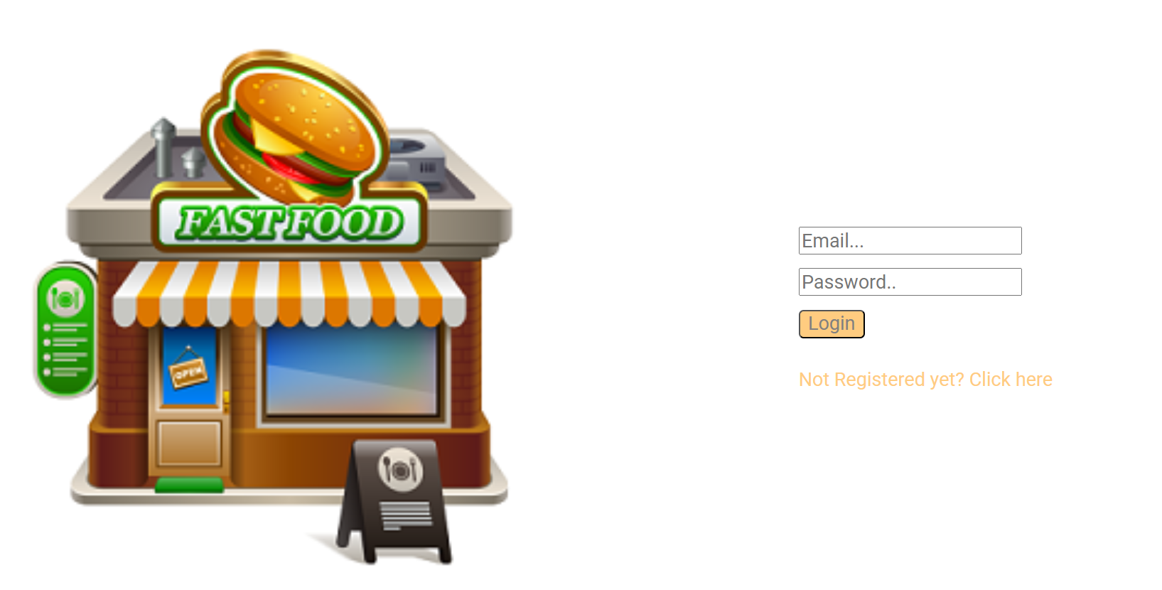
Login Page:

Slide 5
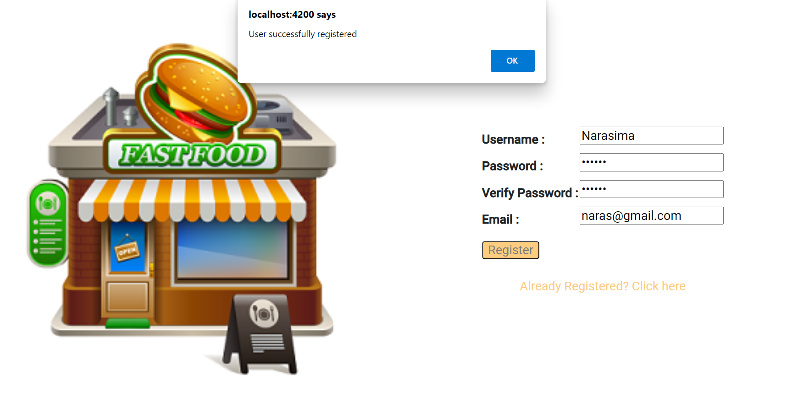
Register Screen with Success msg:

Slide 6
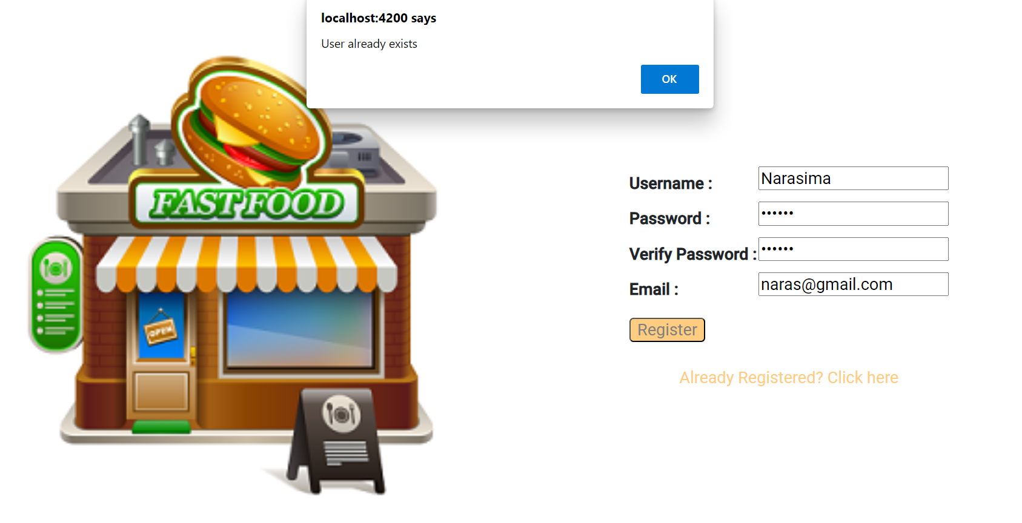
Register Screen with Warning msg:

Slide 7
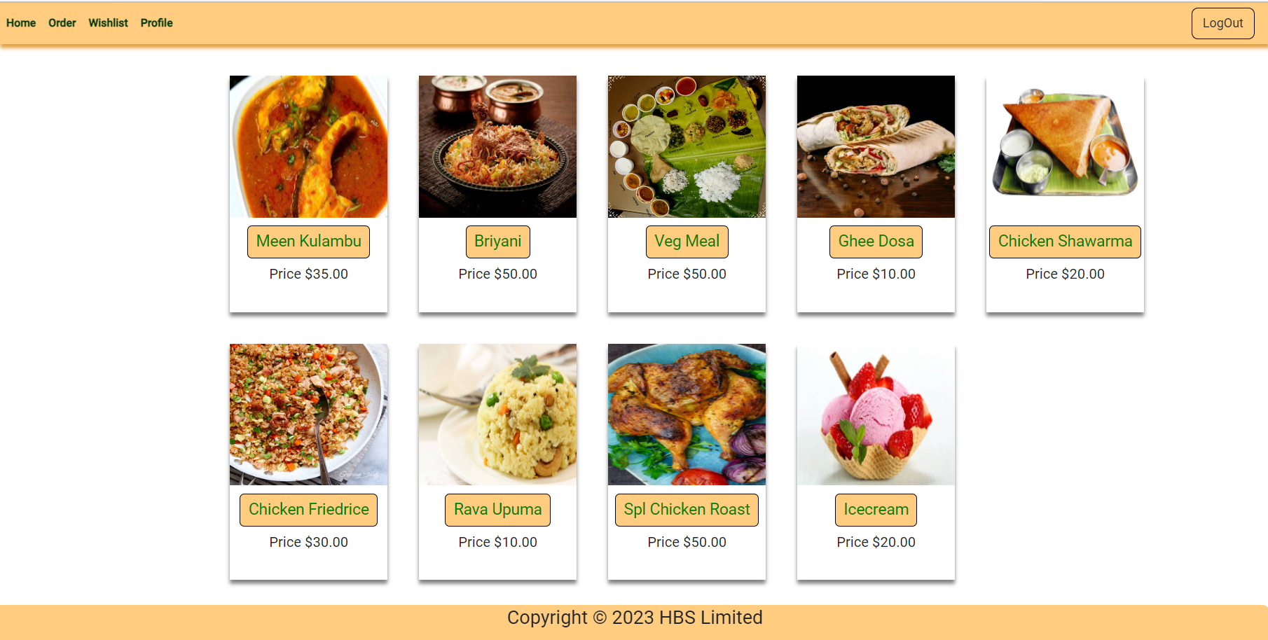
Home page:

Slide 8
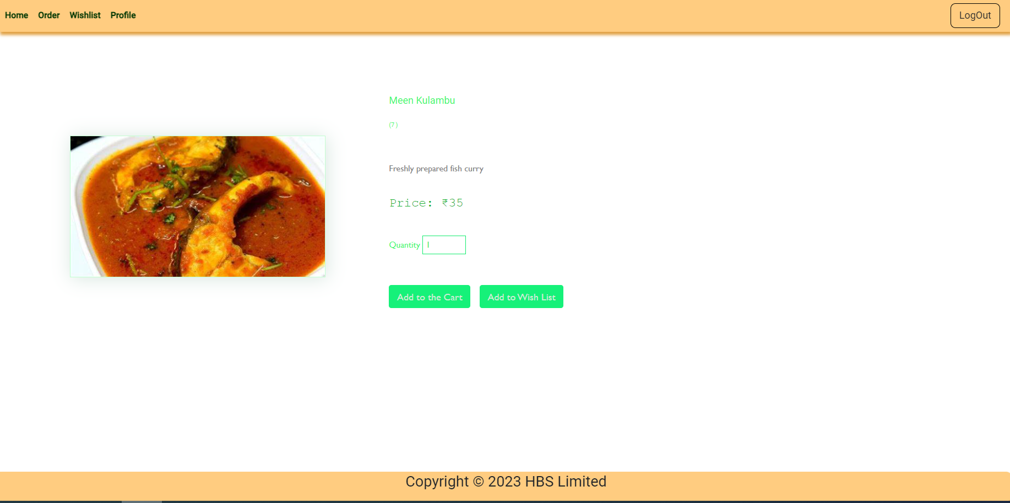
Like To order:

Slide 9
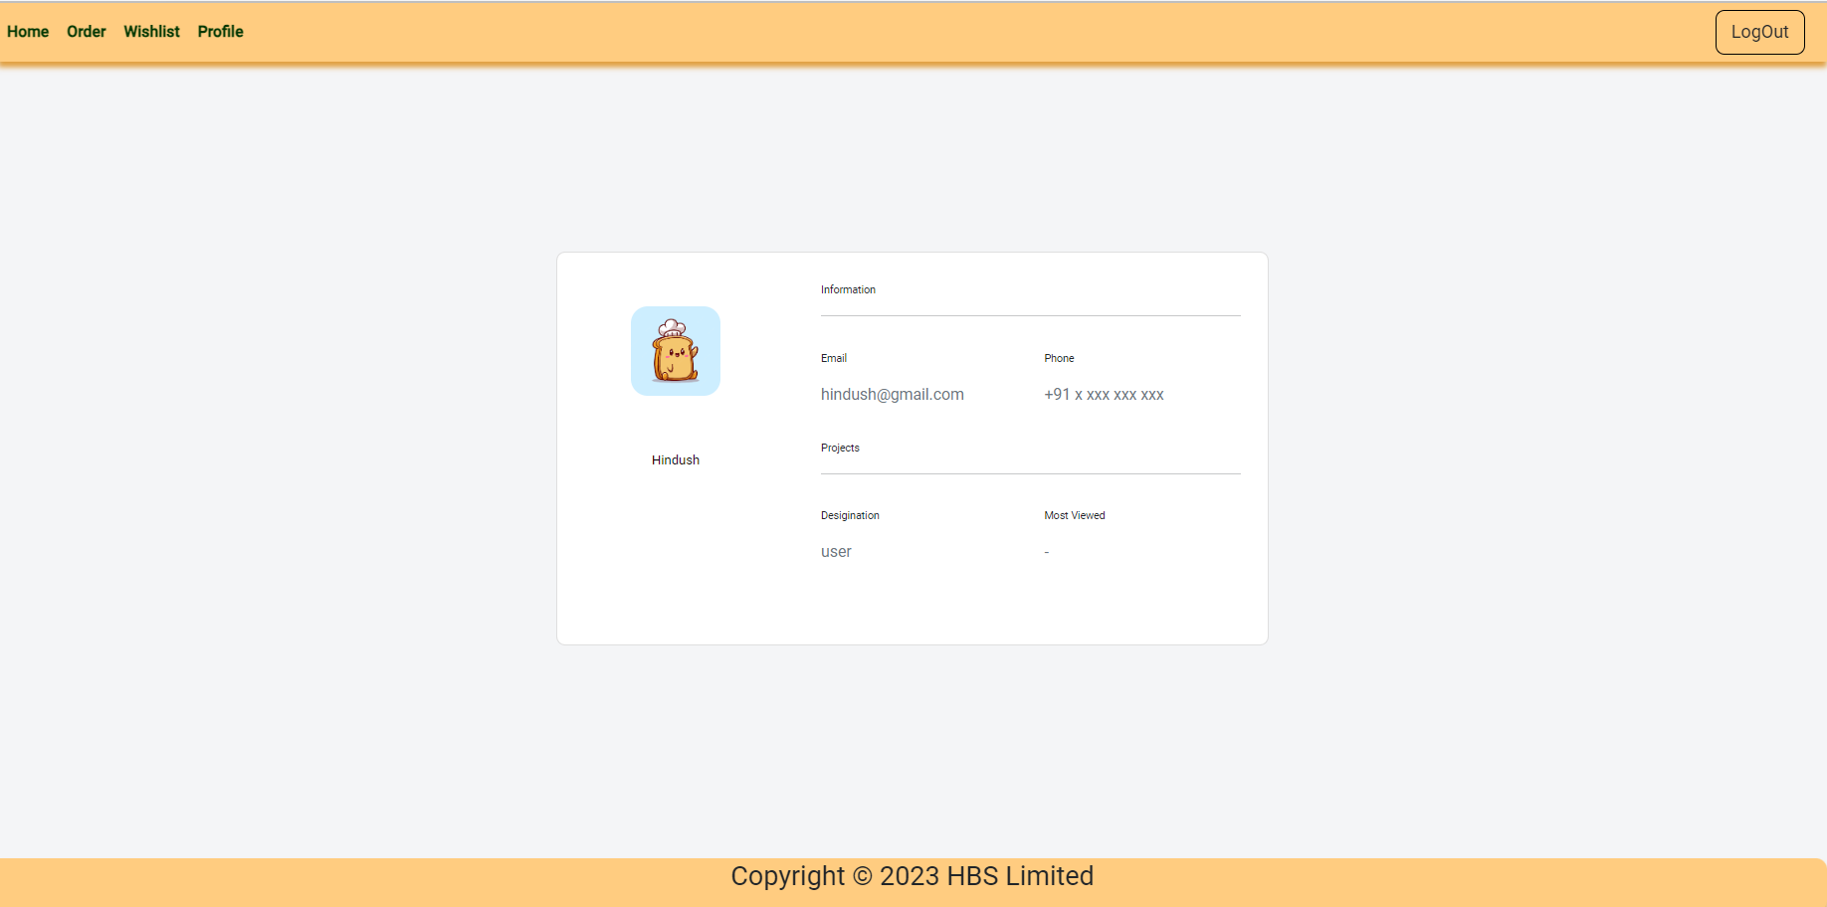
User Profile:

Slide 10
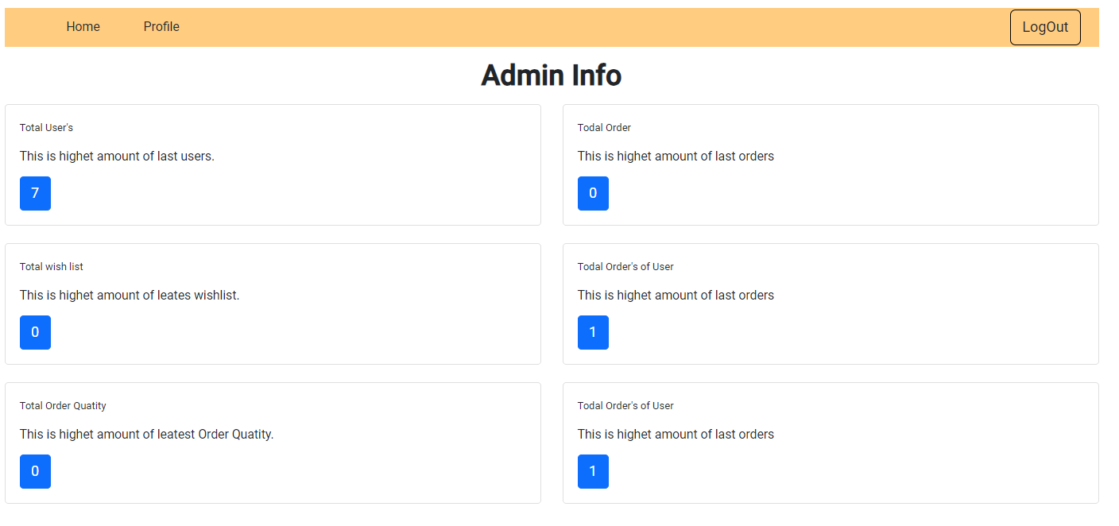
Admin Screen:

Slide 11
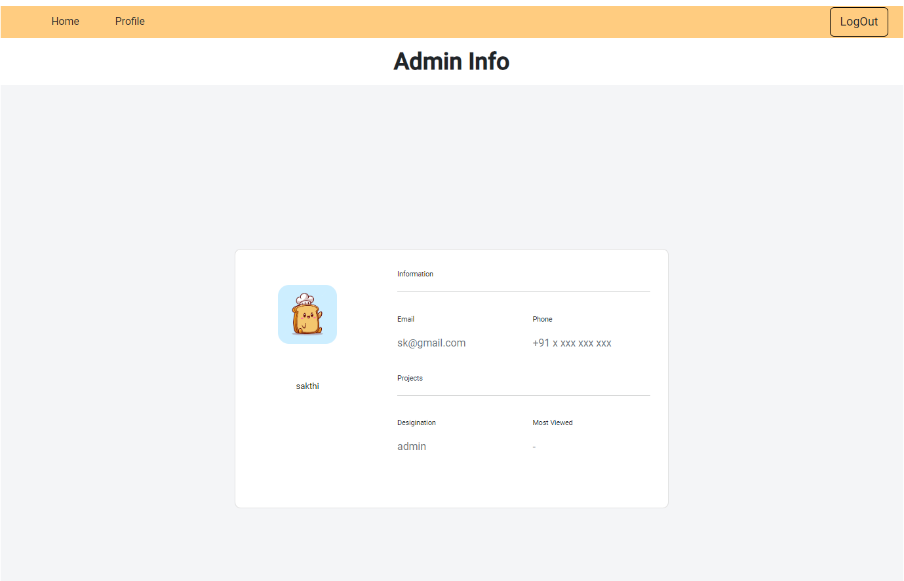
Admin Profile:

Slide 12
Thank You…

